Slide 1
Changing Settings On the Seametrics FT400-Series

Slide 2
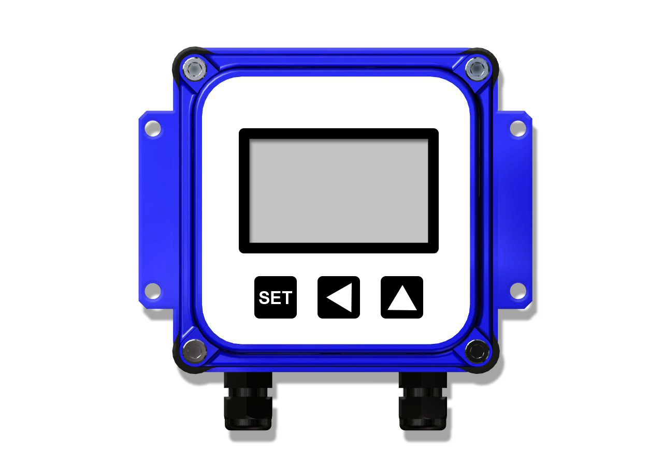
Quick Settings Overview
Large digits display instantaneous flow rate (GPM).
Small digits display total flow (since last reset).
0.00
0.00
MIN
RESET

Slide 3
Quick Settings Overview
K is the number of pulses the flow sensor provides for every gallon of flow.
Find it on the fitting (800-Series) or chart (100/200-Series) or on the Seametrics website.
http://www.seametrics.com/k-factor-calculator
00000.000
SET K

Slide 4
Quick Settings Overview
P is the number of gallons per pulse desired on the scalable pulse output.
(Example: P=1 is one pulse per gallon.) Skip without changing if you are not using the pulse output.
0000000.0
SET P

Slide 5
Quick Settings Overview
20 is the 20 mA maximum analog output. Set the flow rate you want to match maximum output.
This setting appears on the FT420 ONLY.
0000000.0
SET 20

Slide 6
Quick Settings Overview
*NOTE: Use the up arrow key to reach your desired digit. Then press the left arrow key to move to the next digit. Repeat the process until the entire number is entered.
0000000.0
SET 20

Slide 7
Quick Settings Overview
d is the decimal point. It toggles back and forth with the up arrow key . Set as many decimal places as needed.
For higher flows, no decimal allows maximum number of whole digits.
0.00
p

Slide 8
Quick Settings Overview
MIN is the time base, for example, gallons per minute.
Use the up arrow key to select sec/min/hour/day.
MIN

Slide 9
Settings: K-Factor
At a minimum, every FT400-Series flow computer must be programmed with the “K-factor”.
K-factor = the number of pulses that the meter produces per gallon of flow.
00000.000
SET K

Slide 10
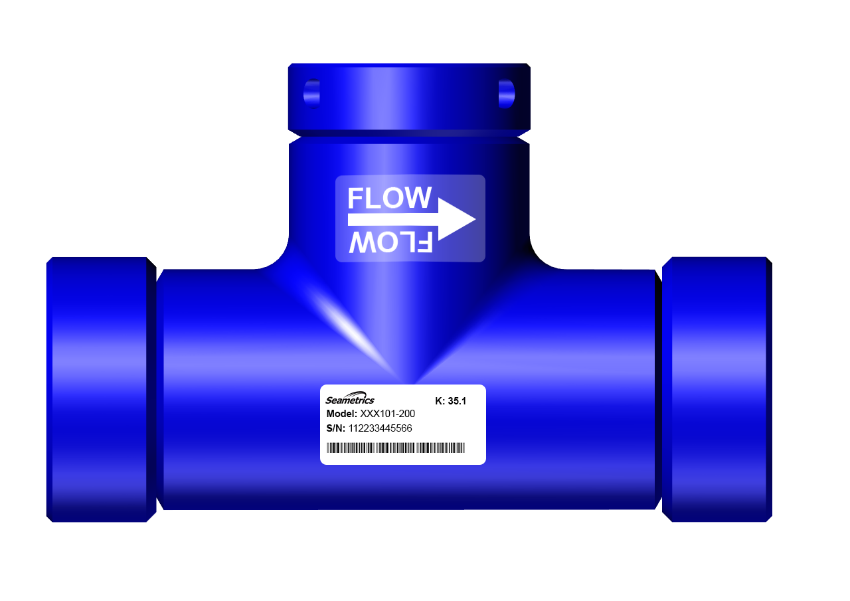
Settings: K-Factor
The K-factor on any Seametrics flow sensor fitting or in-line meter can be found on the model-serial label. The line reading K = xxx gives the desired number. For depth-adjustable sensors (110, 210, 150, 250 models), use the calculator on our website.

Slide 11
K-Factor: Reading in Other Units
Changing Volume Units
The default K-factor units are pulses per gallon. To read your total in metric or other units instead, the standard K-factor must be converted to the desired volume units. For example, to read in pulses per liter, the K-factor must be multiplied by the applicable number shown in the chart to the right.
To Convert K to: | Multiply by:
Liters | .26418
Cubic Meters | 264.18
Fluid Ounces | .0078
Cubic Feet | 7.48

Slide 12
K-Factor: Reading in Other Units
Changing Time Units
To read your rate in liters per second (for example), convert the K-factor volume units as shown previously and change the time units to Seconds, using the Set Time Unit.
MIN

Slide 13
Set K
Begin by pressing the SET key once. The prompt SET K should appear on the display. The digit to the far right will be blinking.
2
0.00
1
2
00000.000
0.00
1
MIN
SET K
Press the left arrow key to move to the next digit.
RESET
Use the up arrow key to reach your desired value.

Slide 14
Set K
Repeat the process until the entire number is entered. (Note that the decimal is fixed at three places. If you only have two decimal places for your K-factor, enter a zero for the third digit.)
Press SET to advance.
00123.450
SET K

Slide 15
Set K
Note: If unable to set K-factor, the unit is "locked" to prevent tampering.
Please contact your Distributor for assistance.
00000.000
SET K

Slide 16
Set P/Flow Alarm
At this screen you may select between pulse output (P) or flow alarm (A) functions. If the pulse output and flow alarm features are not being used, this step can be skipped.
The P (pulse output) setting does not affect anything if it is not being used.
0000000.0
SET P

Slide 17
Set P/Flow Alarm
Set P is the default that appears on a new FT400-Series. On an FT400 that has been previously set up with flow alarm function, an A will appear on this screen.
To move between P and A screens, firmly press all three keys for 5-10 seconds, then use the up arrow to scroll through the three options: P, AL HI (high flow alarm) and
AL LO (low flow alarm).
Al lo
p
Al hi
0000000.0
SET P
5-10 seconds

Slide 18
Set P/Flow Alarm
Set P
From this screen, follow the same process as for Set K
to enter the desired pulse rate. This is the number of gallons
(or whatever units are programmed) between pulses.
(Note: Using the pulse output function disables the high and low flow alarm functions.)
(6.1 Hz max output)
0000000.0
2.
1
SET P

Slide 19
Set 20 mA
Set 20 mA (FT420 Only)
Press the SET key to advance to SET 20, to set the flow rate, in volume units per time unit, at which 20 mA is desired. Use the up arrow key to reach your desired value.
Then press the left arrow key to move to the next digit.
0000000.0
2.
1
SET 20

Slide 20
Set 20 mA
Repeat the process until the entire number is entered. The processor will automatically scale the 4-20 mA loop accordingly, with 4 mA at zero flow.
For example, if the maximum expected flow is 250 gpm, set 20 to 250. The analog output will scale to 4 mA at zero flow, 20 mA at 250 gpm.
0000250.0
SET 20

Slide 21
Set Decimal Point
Set Decimal Point
Press the SET key again for the D prompt.
Pressing the up arrow key switches among no decimal place, one decimal place and two decimal places.
0.0
p
0.
0

Slide 22
Set Time Unit
Set Time Unit
When the SET key is pressed again, a blinking time unit appears.
Press the up arrow key to select SEC (seconds), MIN (minutes), HR (hours) or DAY (days).
SEC
MIN
HR
DAY
(for example, gal/min, or gal/hr)

Slide 23
Thank You for Choosing Seametrics

