Slide 1
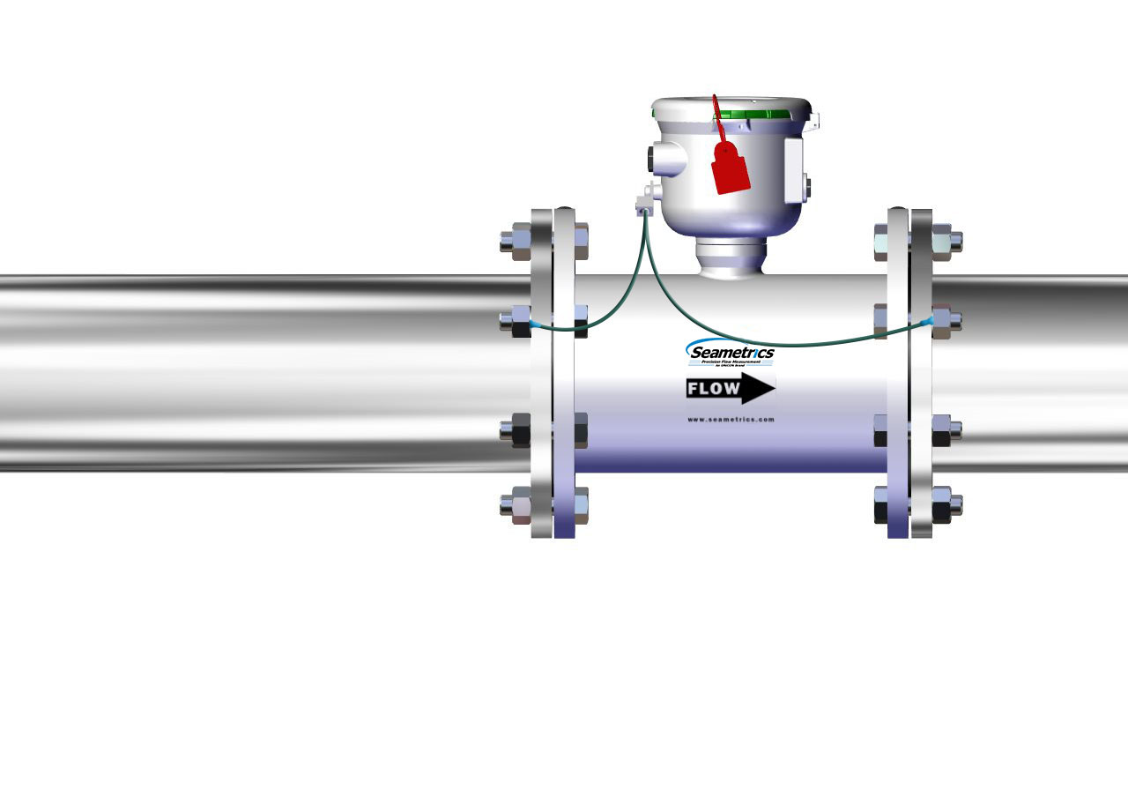
AG3000
Horizontal Installation Overview

Slide 2
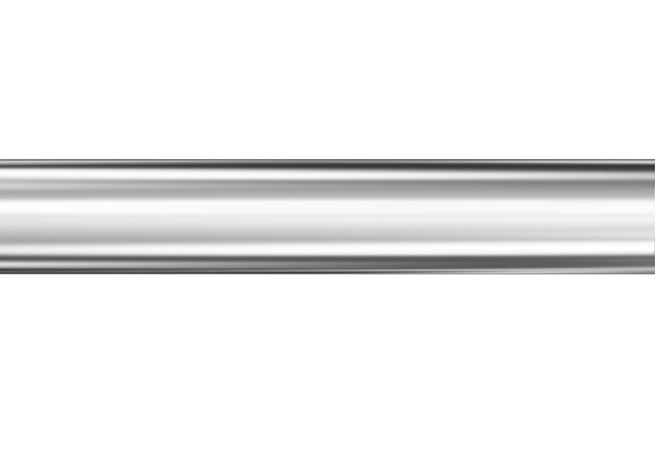
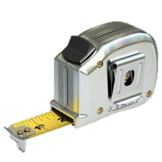
Step 1
You’ll Need:
Total minimum straight pipe for your meter – see below.
Tape Measure
Meter + Flanges
+ Gaskets
+ Grounding rings
1X Pipe
Diameter
Downstream
2X Pipe Diameter
Upstream
AG3000-300 22“ total minimum straight pipe
AG3000-400 22“ total minimum straight pipe
AG3000-600 30" total minimum straight pipe
AG3000-800 38" total minimum straight pipe
AG3000-1000 48“ total minimum straight pipe
AG3000-1200 60" total minimum straight pipe
Measure the horizontal straight pipe from pump.
Ensure there is sufficient straight pipe to meet the requirements of the meter.
Installing an AG3000

Slide 3
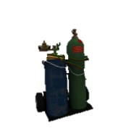
Step 2
You’ll Need:
1X Min. Pipe
Diameter
Down
Meter + Flanges
+ Gaskets
+ Grounding rings
2X Min. Pipe Diameter
Upstream
Tape Measure
Cutting Tools
This meter is sensitive to heat. Do not weld or flame cut within 10’ of meter. Heat will damage electronics and liner. (Heat damage will void warranty.)
Cut out a section of straight pipe, insuring there are at least two pipe diameters of straight pipe on the inlet side of the meter, and one pipe diameter of straight pipe on the outlet side of the meter.
Installing an AG3000

Slide 4
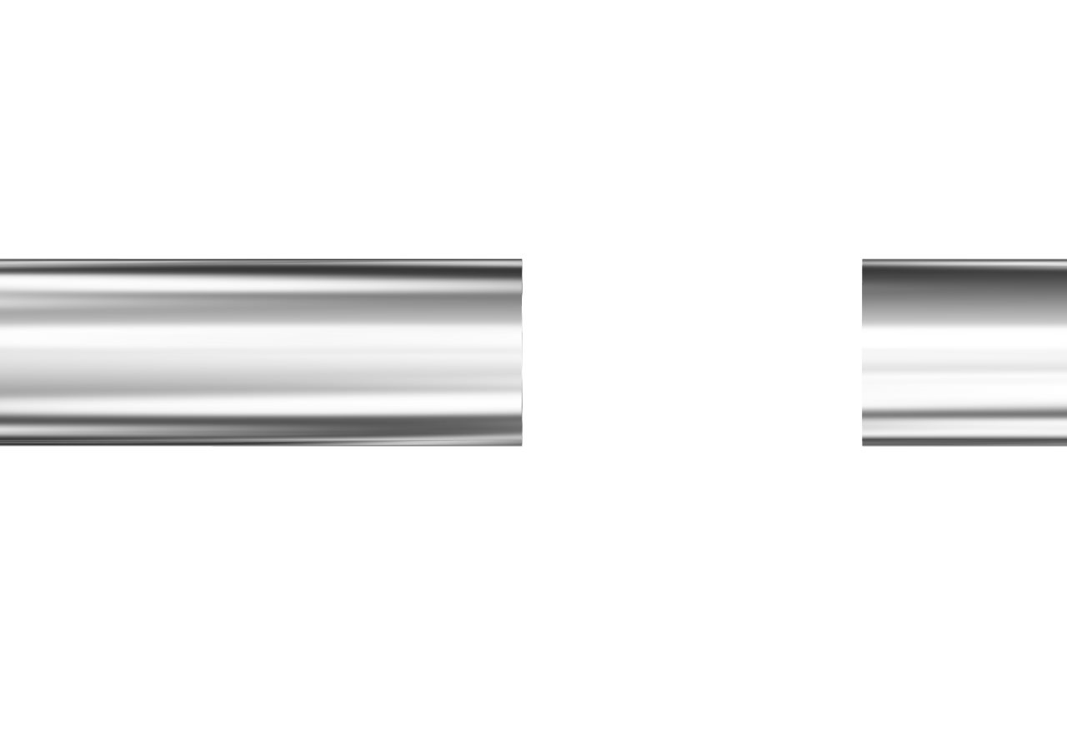
Step 3
You’ll Need:
1X Min. Pipe
Diameter
Down
Meter/Flanges/
Gaskets/
Grounding rings
2X Min. Pipe Diameter
Upstream
Tape Measure
Cutting Tools
This meter is sensitive to heat. Do not weld or flame cut within 10’ of meter. Heat will damage electronics and liner. (Heat damage will void warranty.)
Cut out a section of straight pipe, ensuring there are at least two pipe diameters of straight pipe upstream of the meter, and one pipe diameter of straight pipe downstream of the meter.
Installing an AG3000

Slide 5
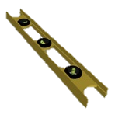
Step 4
You’ll Need:
Tape Measure
Welding Tools
Level
This meter is sensitive to heat. Do not weld or flame cut within 10’ of meter. Heat will damage electronics and liner. (Heat damage will void warranty.)
Weld the appropriate ANSI pattern flanges on each open end of pipe, ensuring the flanges are parallel, and the flange bolt holes are aligned.
Allow the welds to cool to ambient temperature.
Installing an AG3000

Slide 6
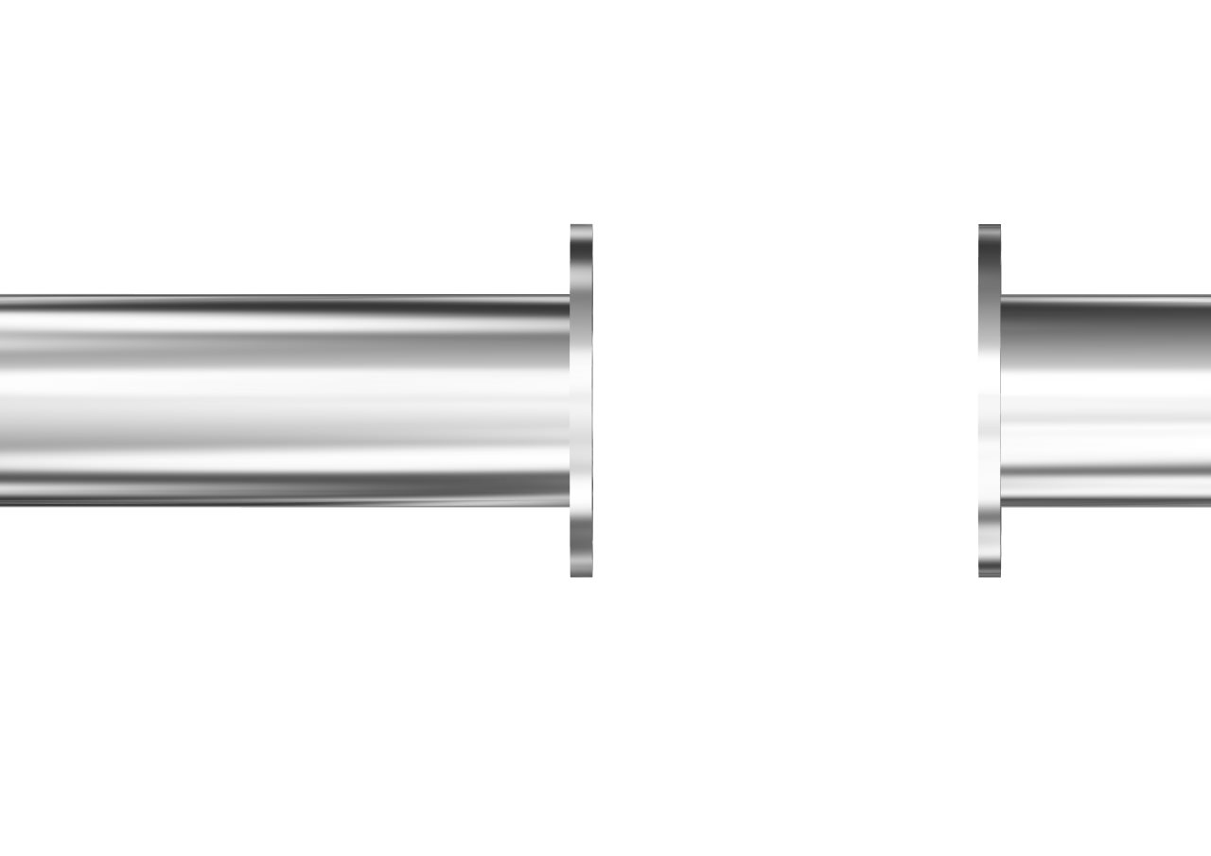
Step 5
You’ll Need:
Ensure bolt holes are aligned
Tape Measure
WARNINGS:
THE HEAT AND/OR ELECTRICAL
CURRENTS FROM THE WELDER
WILL DAMAGE THE METER
AND VOID THE WARRANTY.
THE PIPE MUST NOT EXTEND
PAST THE SURFACE OF THE
FLANGE
Welding Tools
Level
This meter is sensitive to heat. Do not weld or flame cut within 10’ of meter. Heat will damage electronics and liner. (Heat damage will void warranty.)
Weld the appropriate ANSI pattern flanges on each open end of pipe, ensuring the flanges are parallel, and the flange bolt holes are aligned.
Allow the welds to cool to ambient temperature.
Installing an AG3000

Slide 7
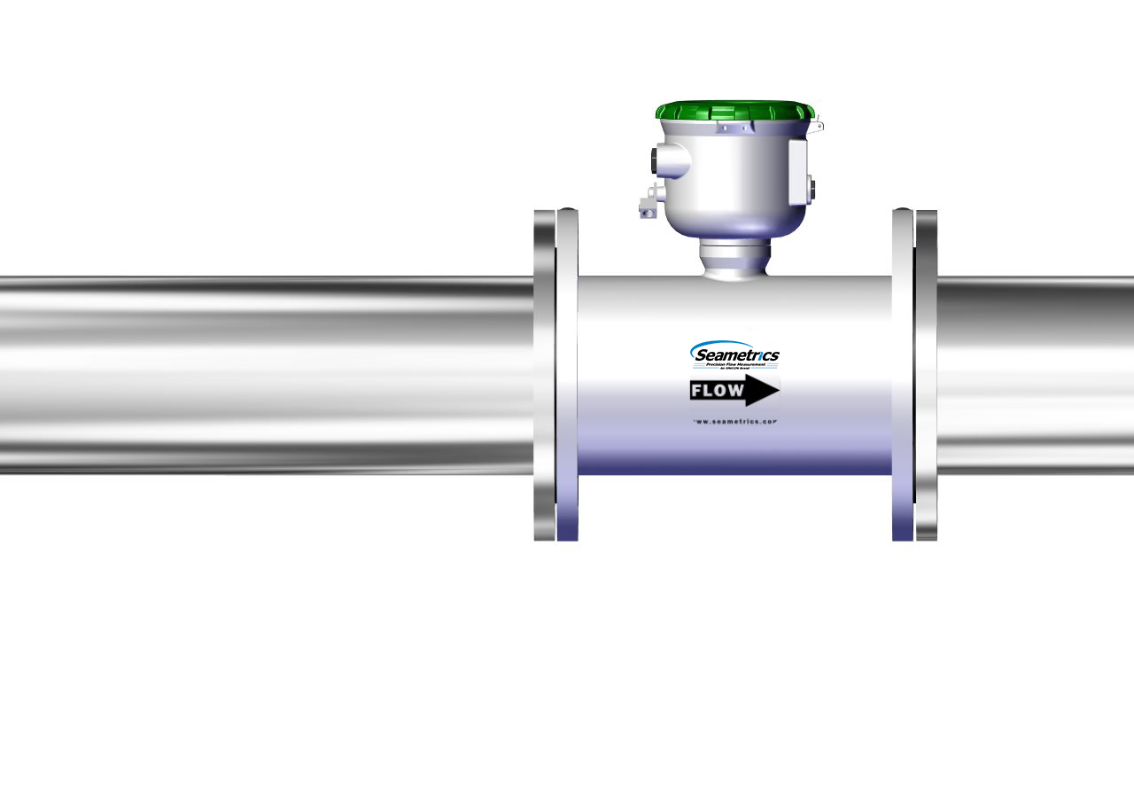
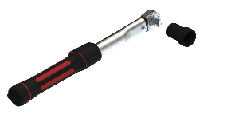
Step 6
You’ll Need:
Although the meter is shown installed in the 12:00 position for visual purposes, which is acceptable, the ideal installation is to rotate the meter one bolt hole to a slightly angled position.
Torque Wrench
FLOW
Flow arrow points downstream
Install only with full face gasket on each end of the meter.
Insert the meter, gaskets and grounding rings (if applicable), with the direction arrow on the side of the meter pointed down stream in the direction of the flow.
Installing an AG3000

Slide 8
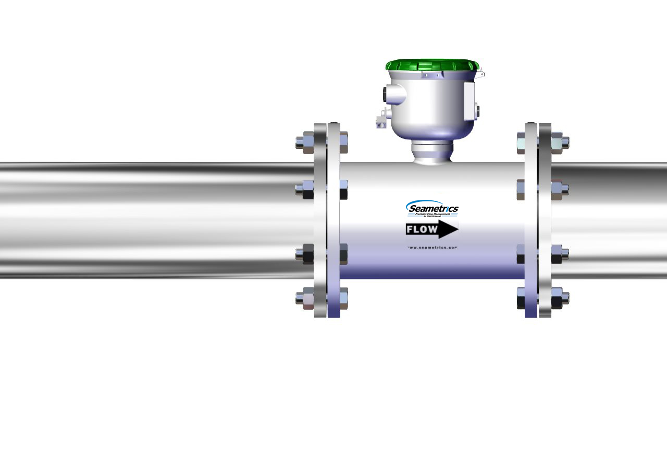
Step 6
You’ll Need:
Torque Wrench
AG3000-300 25 ft-lb
AG3000-400 20 ft-lb
AG3000-600 42 ft-lb
AG3000-800 65 ft-lb
AG3000-1000 73 ft-lb
AG3000-1200 97 ft-lb
1
5
8
3
4
7
6
2
Bolt the meter to the flanges using the appropriate sequence and torque.
Installing an AG3000

Slide 9
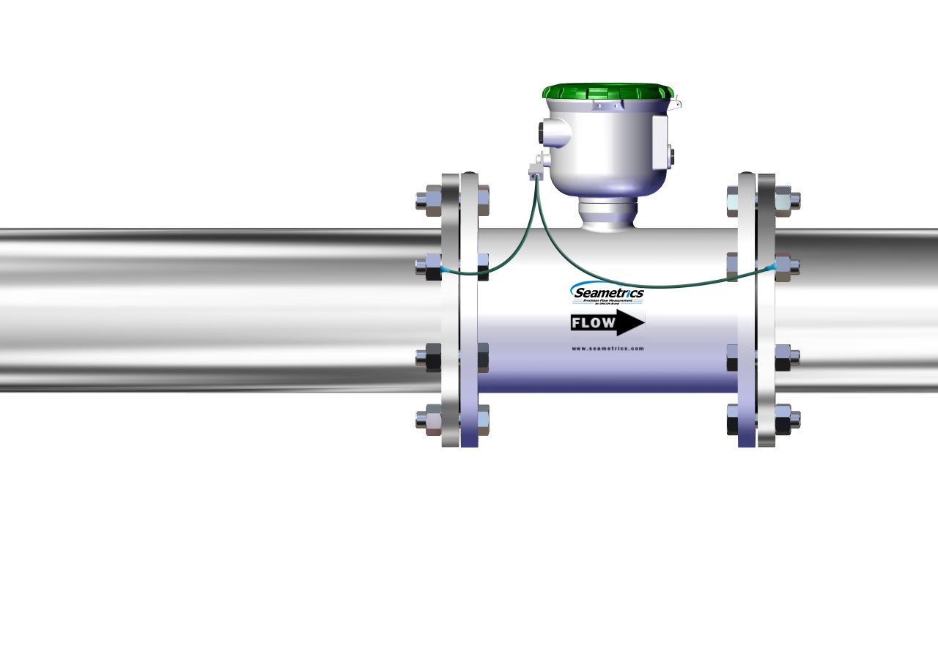
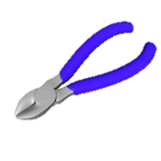
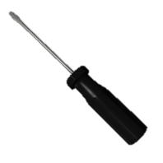
Step 7
You’ll Need:
Torque Wrench
Wire Cutters
#2 Phillips Screw Driver
Tab on pipe flange
NOT
meter flange
Tab on pipe flange
NOT
meter flange
Install the equalization wires and tabs from the lug to the outside pipe flanges (not in direct contact with the meter) for proper electrical grounding.
Installing an AG3000

Slide 10
Step 8
You’ll Need:
Torque Wrench
Wire Cutters
#2 Phillips Screw Driver
^{Ensure proper grounding.}
See instruction manual for more information on grounding the meter.
Install the equalization wires and tabs from the lug to the outside pipe flanges (not in direct contact with the meter) for proper electrical grounding.
Installing an AG3000

Slide 11
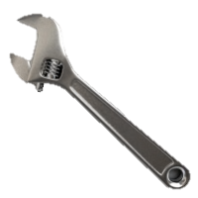
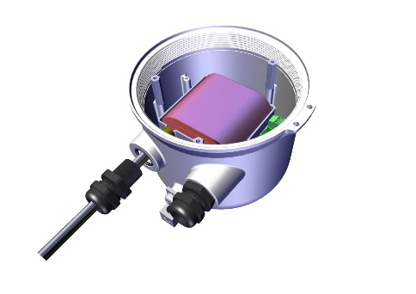
Step 9
You’ll Need:
Wrench
Wire Cutters
#2 Phillips Screw Driver
Inspect and clean O-ring and threads on plastic wire gland and cap.
If cables from meter to other electronics will be needed in the field, install cables. See manual for specific wiring requirements for your application.
Installing an AG3000

Slide 12
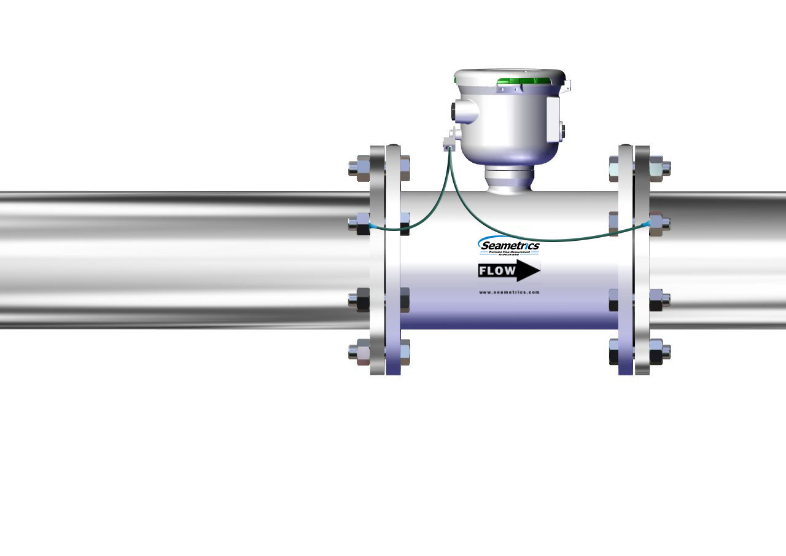
Step 10
You’ll Need:
If meter does not have a factory installed hinged weather guard, attach the weather guard cover and lanyard.
Installing an AG3000

Slide 13
Step 11
You’ll Need:
Connect the security seal.
Installing an AG3000

Slide 14
Step 12
You’ll Need:
Your meter is installed!
Refer to the Seametrics AG3000 Instruction Manual for additional information and programming instructions.
Installing an AG3000

Slide 15
For Additional Support Call: 800-975-8153

